Slide 1
The Titanic Dataset
Baylee Adams, Tyler Lawrence, Kyle Shope, Justin Gould, Mengmeng Zhang

Slide 2
Content
Data set
Data cleaning
T-Test
ANOVA
Tukey
Logistic Regression
Case Studies

Slide 3
The Dataset
Variable | Definition | Key
survival | Survival | 0 = No, 1 = Yes
pclass | Ticket class | 1 = 1st, 2 = 2nd, 3 = 3rd
sex | Sex
Age | Age in years
sibsp | # of siblings / spouses aboard the Titanic
parch | # of parents / children aboard the Titanic
ticket | Ticket number
fare | Passenger fare
cabin | Cabin number
embarked | Port of Embarkation | C = Cherbourg, Q = Queenstown, S = Southampton
Titanic
Kaggle.com

Slide 4
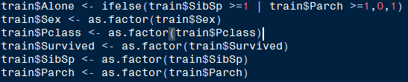
Data Cleaning
Data munging -> Data analysis
Categorical variables

Slide 5
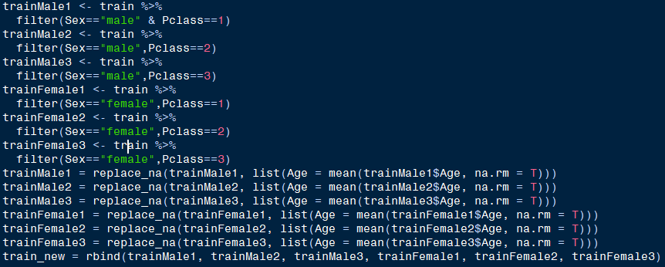
Data Cleaning
Data munging -> Data analysis
Missing values – mean values

Slide 6
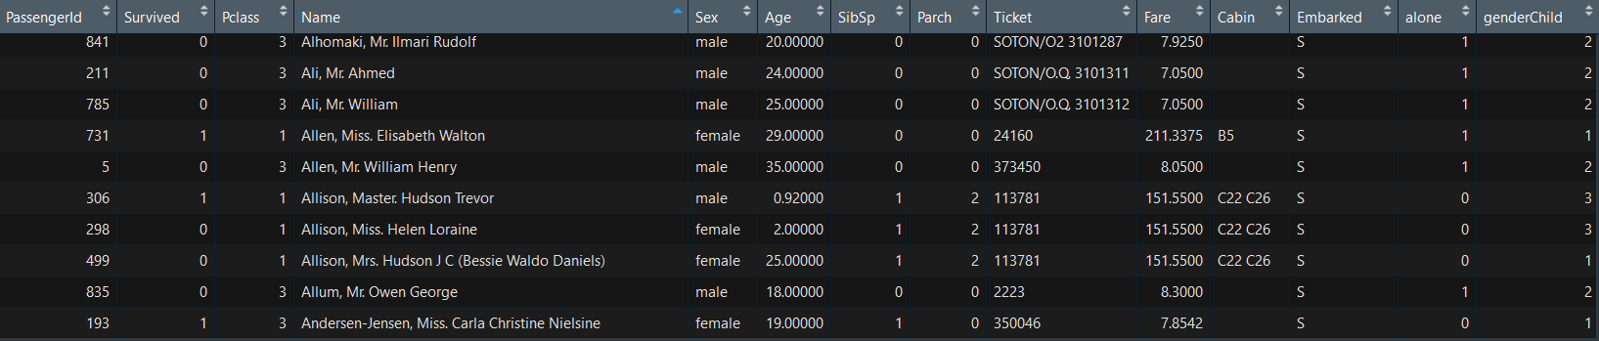
Data Cleaning
Create dummy variables
Alone: Alone on board/ not alone on board
GenderChild: Male/Female/ Child

Slide 7
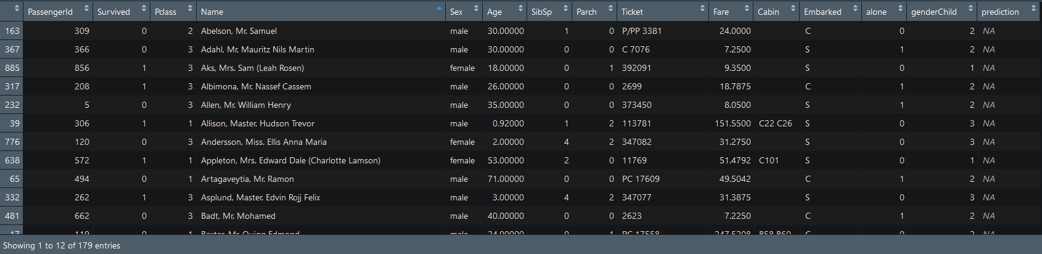
Splitting the Dataset
20% of data randomly selected to create a test set

Slide 8

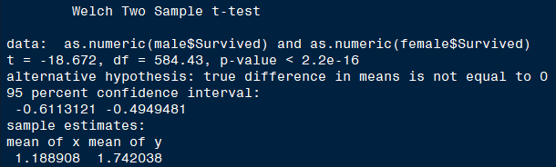
Exploratory Analysis on Sex: T-Test

Slide 9
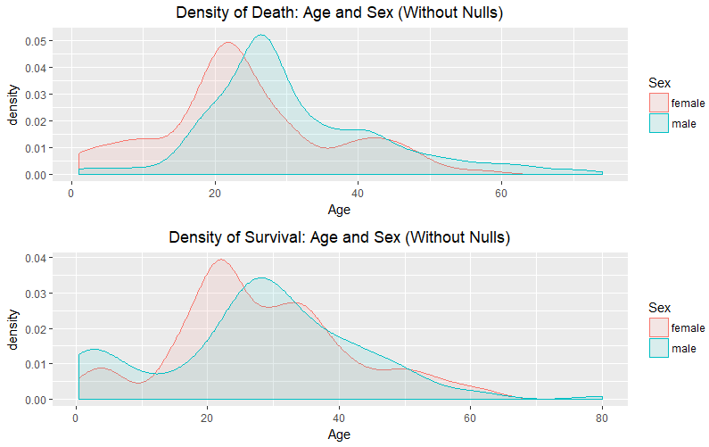
Density

Slide 10
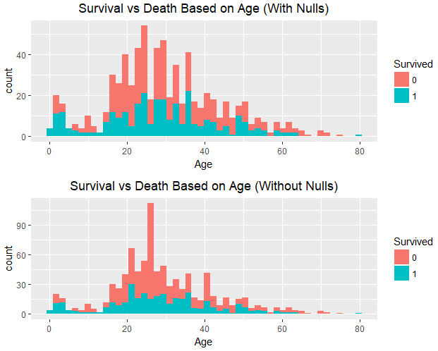

Slide 11
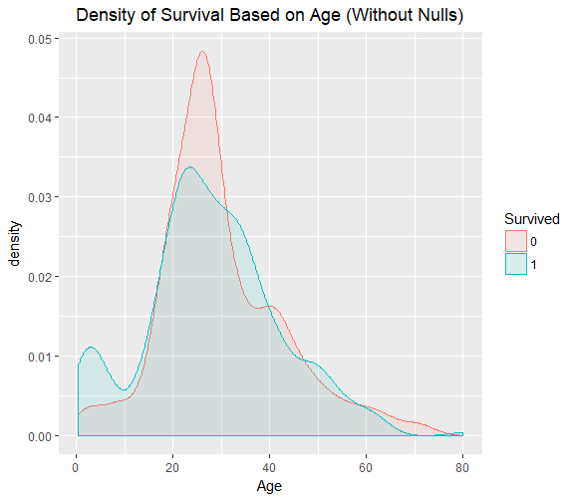
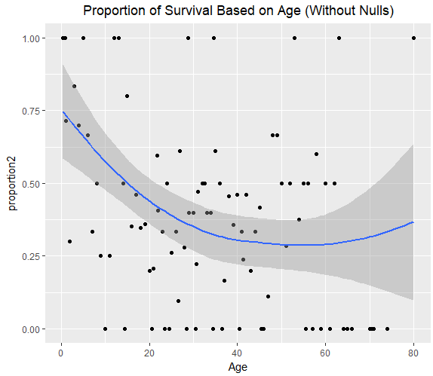

Slide 12

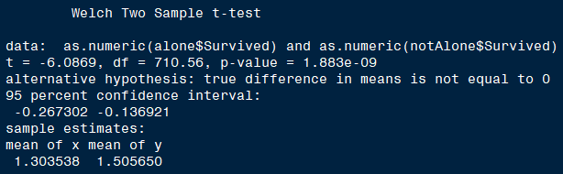
Exploratory Analysis on Alone: T-Test
Make Effective Presentations

Slide 13
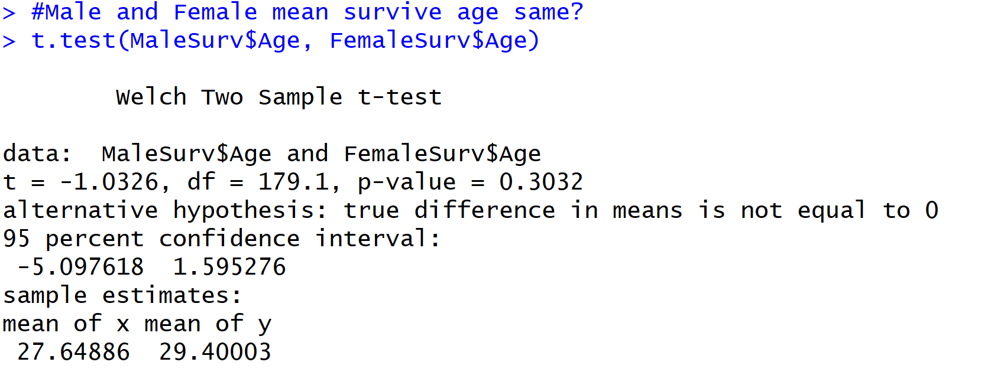
T-Test: Survived Age – Male vs. Female

Slide 14
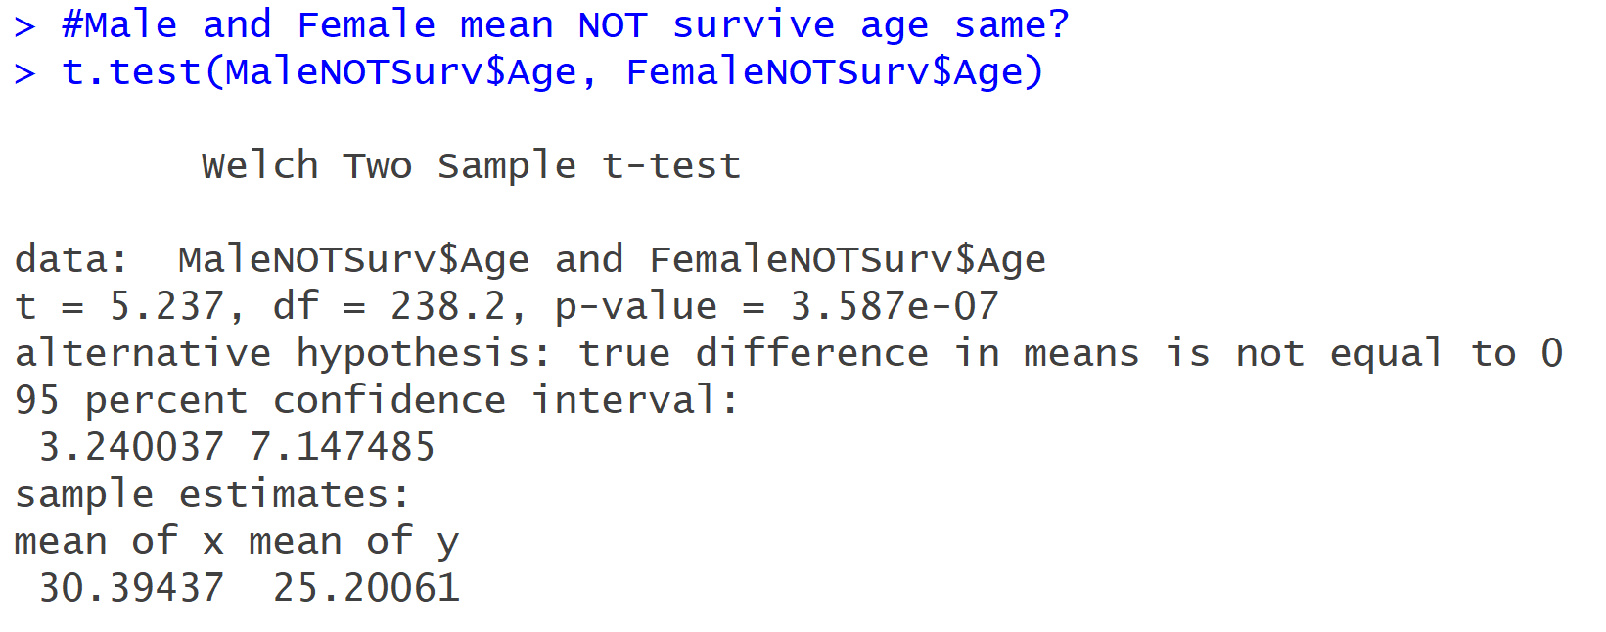
T-Test: Not Survived Age – Male vs. Female

Slide 15
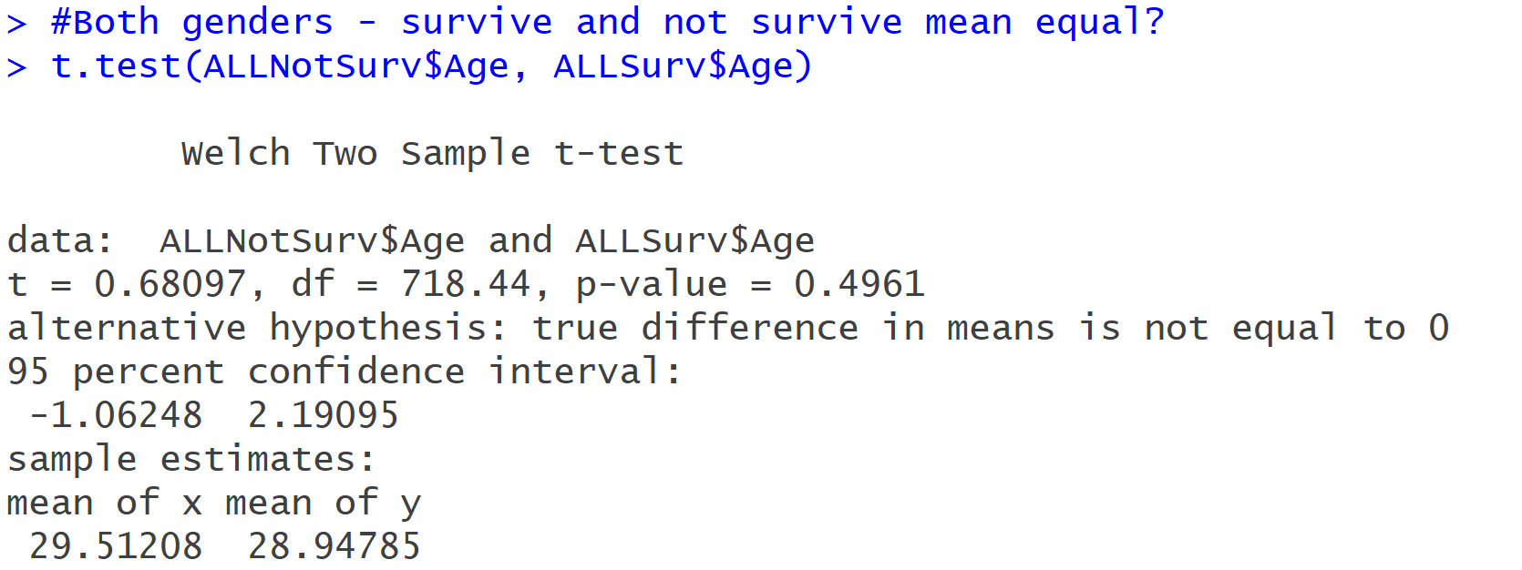
T-Test: Survived vs. Not Survived Age

Slide 16

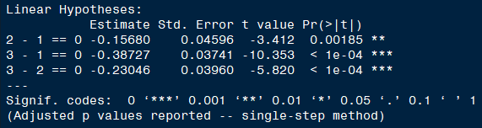
PClass: ANOVA & Tukey

Slide 17
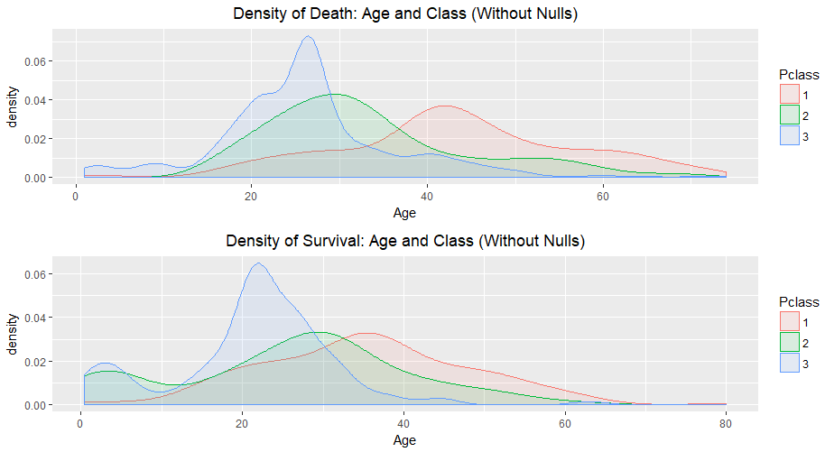
Density

Slide 18
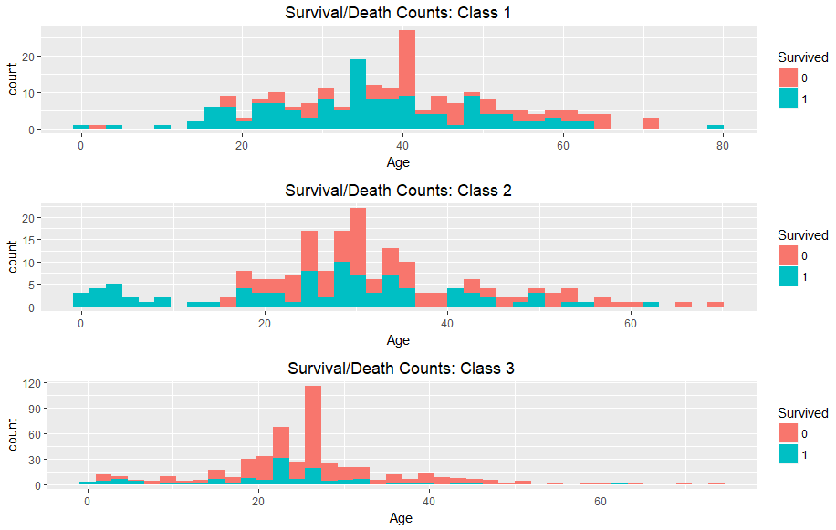
Survival Counts

Slide 19
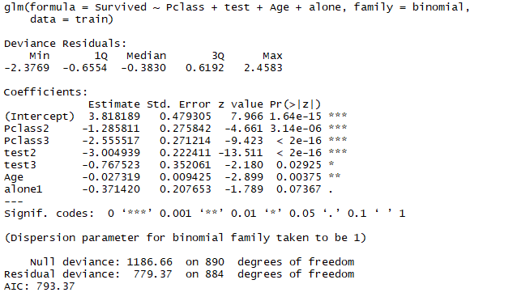
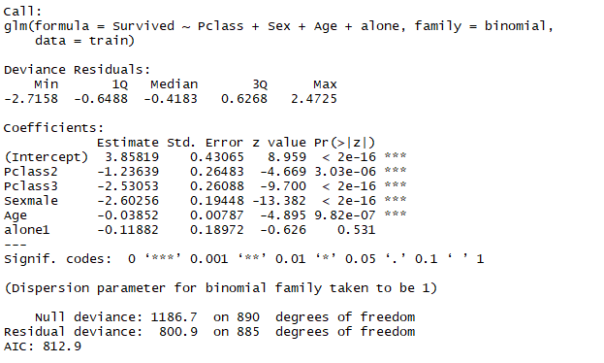
Models with Alone Variable

Slide 20
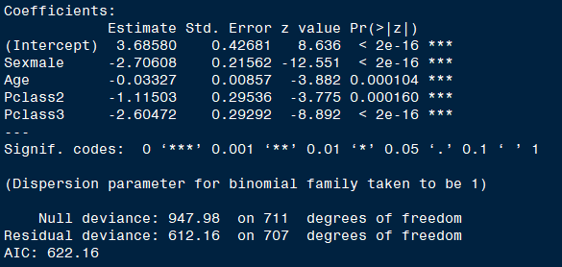
Initial Model

Slide 21
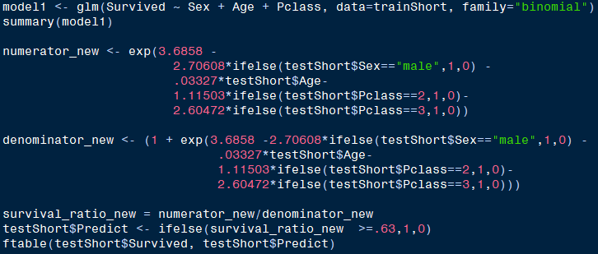


Initial Model

Slide 22
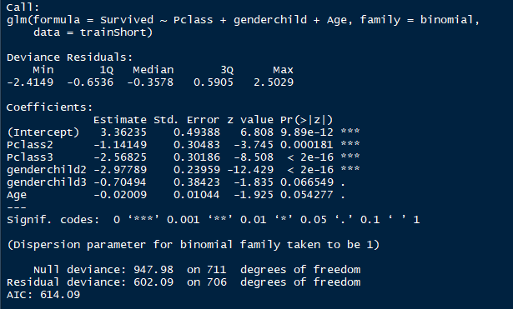
Second Model – ‘GenderChild’ Variable

Slide 23
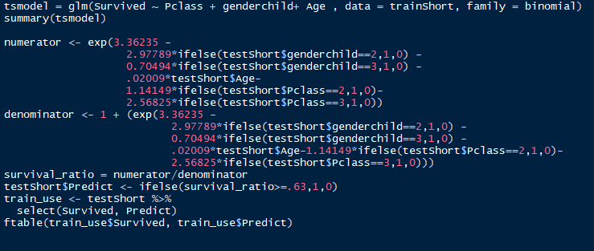


Second Model – ‘GenderChild’ Variable

Slide 24
Logistic Regression –Testing on the 20%
Model 1
Model 2
Accuracy
73.18%
Sensitivity - Predicting Survival
37.68%
Specificity – Predicting Death
95.45%
Accuracy
74.86%
Sensitivity - Predicting Survival
36.23%
Specificity – Predicting Death
99.09%

Slide 25
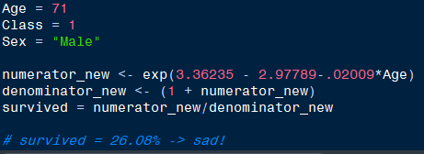
Would Donald Trump Survive the Titanic?

Slide 26
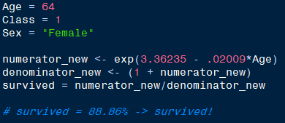
Would Oprah Survive the Titanic?

Slide 27

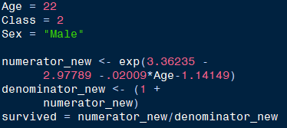
Would Fred Survive the Titanic?

